Slide 1




Shaping Future India
OPEN FOOD FACT : REFORMULATE TO WIN

Slide 2
PROJECT OVERVIEW
The objective of this project is to analyze food and beverage products using nutrition data from the Open Food Facts database to:
Evaluate product healthiness
Identify unhealthy product clusters
Benchmark brands based on health scores
Suggest reformulation opportunities

Slide 3
DATA SOURCE & TOOLS USED
Data Source
Open Food Facts (OFF) – Global open database of food products
Nutrition information such as:
  Energy, Fat, Saturated Fat, Sugar, Salt, Vegan & Palm oil indicators
Tools & Technologies Used
Python → Data extraction & cleaning
SQL Server → Data storage & analysis
Power BI → Dashboard & visualization
Excel → Data validation & export

Slide 4
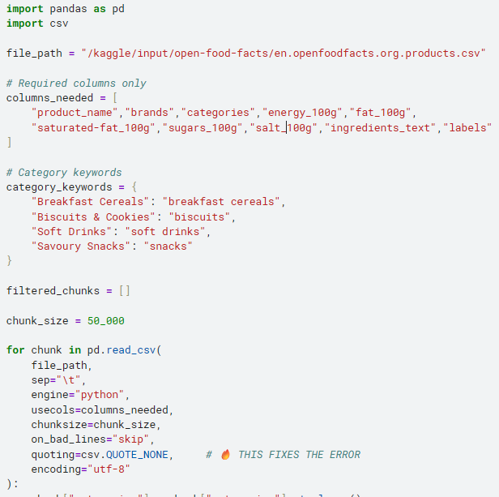
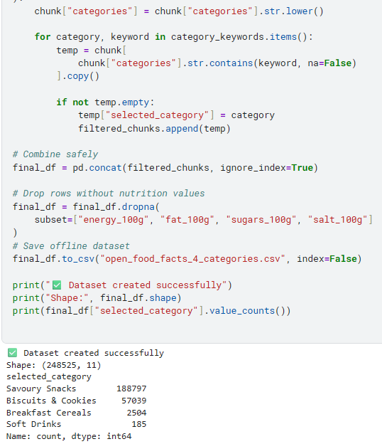

Slide 5
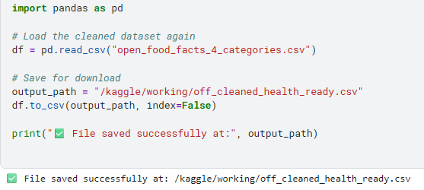
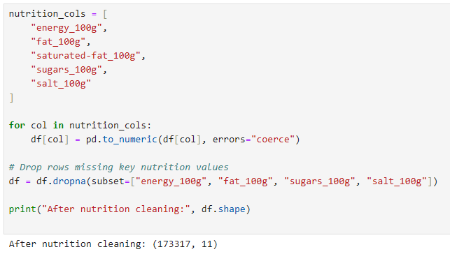
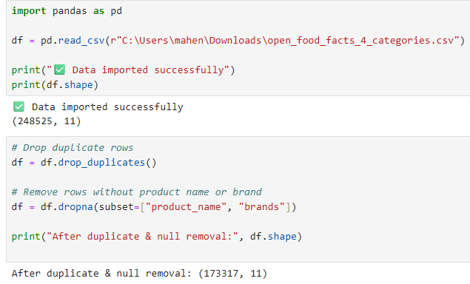

Slide 6
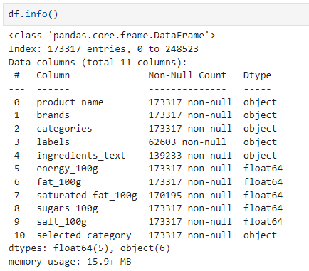
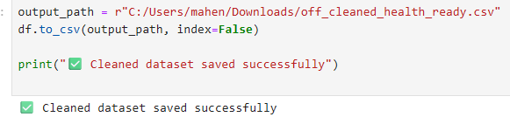

Slide 7
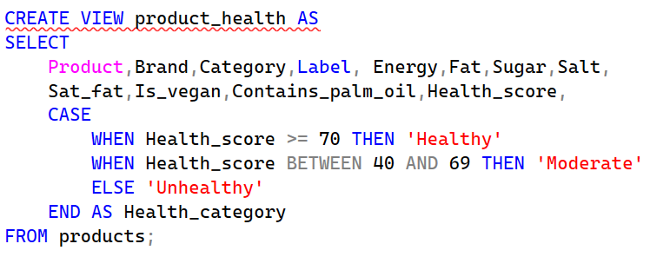
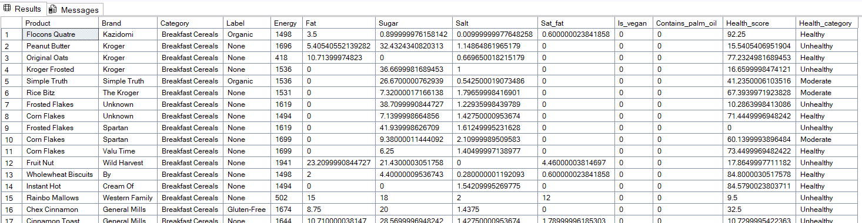

Slide 8
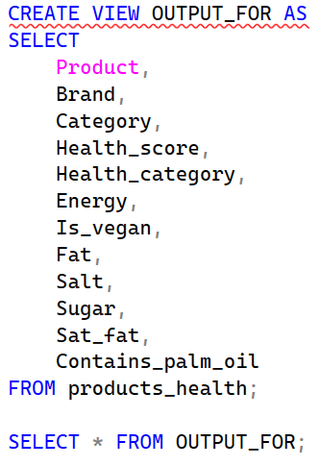
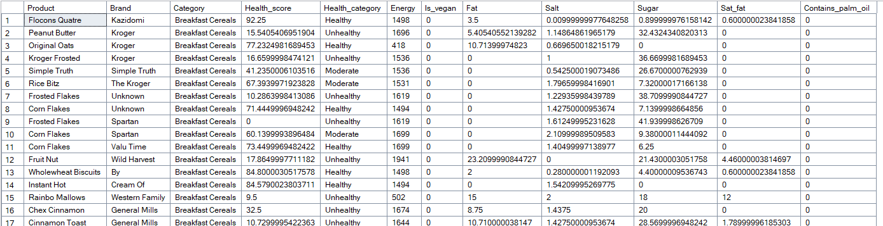

Slide 9


Slide 10
KEY INSIGHTS
Certain FMCG categories have a high percentage of unhealthy products
Sugar and salt are the primary drivers of low health scores
A few brands consistently outperform others in health metrics
Many products can improve health score with small reformulation changes
Vegan and palm-oil-free products offer strong marketing opportunities

Slide 11
CONCLUSION
This project successfully demonstrates how open nutrition data can be transformed into actionable business insights.
By combining Python, SQL, and Power BI, the analysis helps FMCG companies:
Understand product health performance
Identify reformulation priorities
Strengthen brand positioning
Make data-driven marketing decisions

Slide 12

Thank You
Thank You

